Slide 1

Raising Awareness of Autism in The Workplace

Slide 2

One way that companies can raise awareness of autism is through education and training. So, with the support of professional bodies, such as the IOSCM, I have created a brief presentation around raising awareness of autism. This is another step to support and encourage businesses to actively seek out and give people with autism a chance of employment.
Tim Young
IoSCM Ambsassdor & Recipient of The Kevin Rumfitt Award 2023
We value Tim’s insights into the challenges those with Autism can face in the workplace and agree that through raising awareness we can create better environments in order to harness and develop all that every individual has to contribute.
Jacky Stansfield Smith, CEO
Institute of Supply Chain Management (IoSCM)
“
”

Slide 3

What We Will Discuss
Defining Autism
Autism & Wellbeing
The Issues with Employment for people with Autism
How we can help to improve awareness and be more inclusive
My Personal Journey, for context

Slide 4



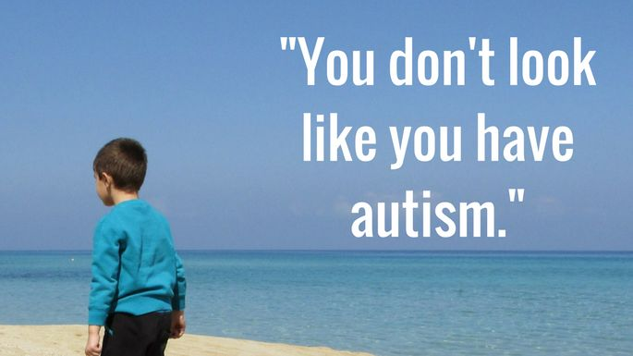
Defining Autism: What is Autism?
Mental illness
Like Rain Man
Its not a mental illness
Its not like being Rain Man
A behavioural quirk
Something you can tell
People are not like Sheldon
Its not something you can see

Slide 5




Defining Autism: Development Differences
Autism is a lifelong developmental disability which affects how people communicate and interact with the world. One in 100 people are on the autism spectrum and there are around 700,000 autistic adults and children in the UK.
original view of the world
Unique ways of communicating
Distinctive behaviours and interactions
Diverse individuals
Autism spectrum disorder (ASD) is a developmental disability caused by differences in the brain. People with ASD often have problems with social communication and interaction, and restricted or repetitive behaviours or interests.
People with ASD may also have different ways of learning, moving, or paying attention.

Slide 6

Defining Autism: The Spectrum
High Functioning
Severely Autistic

Slide 7
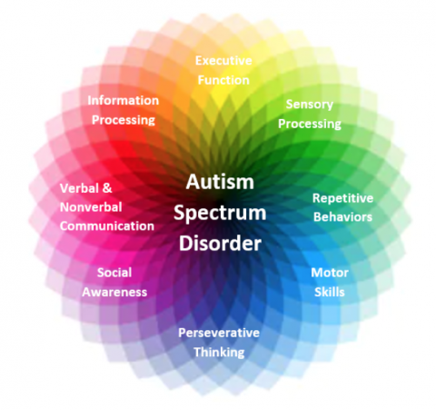
Defining Autism: The Spectrum
Think of the Spectrum as a circle with various Factors.
Each Factor has a high or low intensity and this defines a person with Autism better than a flat line of high functioning or low functioning

Slide 8
Defining Autism: Universal Symptoms Of Autism
Fixated interests abnormal in intensity
Repetitive behaviour, interests or activities
Attachment to sameness, routines and behaviour
Hyper – or hyperactivity to sensory input
Social and communication deficits (verbal and non verbal)
Difficulties in relationship development, maintenance and understanding
all of the symptoms must be present. In addition, the symptoms must not be explainable by another diagnosis.

Slide 9






Defining Autism: Over Or Under Sensitivities

Slide 10
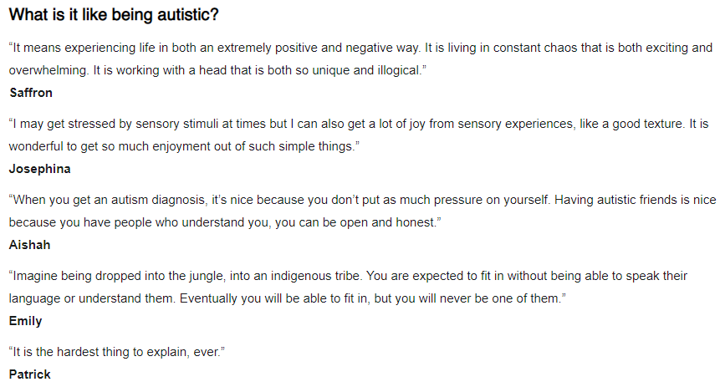

Defining Autism: What Its Like, From People With Autism

Slide 11
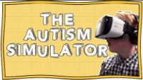
Defining Autism: The Autism Simulator

Slide 12
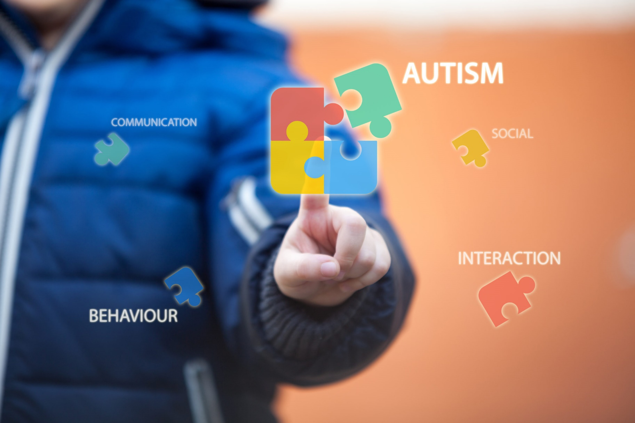
We are not all a bit Autistic
An intense interest for you is more than that to a person with Autism. It’s a lifeline and an escape
Not liking people much should never be confused for the sometimes crippling social anxieties that can come with Autism
Liking routine is not the same as having to have routine or it can be completely world ending to a person with Autism
Being a bit blunt (for example) is a behavioural choice you have, where an Autistic person struggles to communicate and say the right things
So in short; we are NOT all a little bit on the spectrum. Those that are struggle with our next subject; Wellbeing

Slide 13

Wellbeing: Anxiety
Sensory difficulties
Changes in routine
Does not know/understand the rules
Anxious about failure
Poor concept of time
Difficulties with communication
Unsure what is going to happen
Literal interpretation of the situation
Notes:
Anxiety is a real difficulty for many autistic adults, particularly in social situations or when facing change. It can affect a person psychologically and physically and impact quality of life for autistic people and their families. It is very important that autistic people learn to recognise their triggers and find coping mechanisms to help reduce their anxiety.
However, many autistic people have difficulty recognising and regulating their emotions. Over one third of autistic people have serious mental health issues and too many autistic people are being failed by mental health services. Getting support early for children is really important for a healthier development.

Slide 14

Wellbeing: Masking
What is Masking?
Hiding Feelings & Moods
Imitating Others Behaviour including facial expressions
Trying not to go non verbal
Bottling up anxieties, thoughts and stims
Trying to focus on conversations but zoning out
Trying to act normal
All of which can lead to burnout and sensory hangover
Notes:
You may not even realise someone has autism. The perception could be its pretty obvious, it isn’t. Masking is a means a person with autism uses to cope, sometimes its good, sometimes not but either way for a person with autism its mentally draining and its not healthy. I say to people I act differently around whomever I with, I generally get the response “well I do that”. That’s cool, human nature to a degree does that to fit in, but a person with Autism like me it can be really hard. For example, the last Lovell day we had at the Nest, once I got home I literally crashed on the bed and slept. All day I had adapt to many different people and make small talk. Not only that, it was so noisy for me, I couldn’t hear very well. So in short masking all day wiped me out. Often it does.

Slide 15
Wellbeing: Meltdowns & Shutdowns
We are all aware of meltdowns, perhaps the screaming child (or adult) in a supermarket comes to mind, but one of the biggest issues with having Autism is Autistic Burnout, caused a lot by Masking. What are the signs?
FLAT MOOD
SPECIAL INTERESTS DON’T APPEAL
IRRITABLE
UNDER WHELMED
SCARED TO COMMIT
LOW ATTENTION SPAN
OVER WHELMED
CONSTANT ANXIETY
Notes:
Meltdowns and shutdowns can come from too much masking.
When everything becomes too much for an autistic person, they can go into meltdown or shutdown. These are very intense and exhausting experiences.
A meltdown happens when someone becomes completely overwhelmed by their current situation and temporarily loses behavioural control. This loss of control can be verbal (eg shouting, screaming, crying) or physical (eg kicking, lashing out, biting) or both. Meltdowns in children are often mistaken for temper tantrums and parents and their autistic children often experience hurtful comments and judgmental stares from less understanding members of the public.
A shutdown appears less intense to the outside world but can be equally debilitating. Shutdowns are also a response to being overwhelmed, but may appear more passive - eg an autistic person going quiet or 'switching off'. One autistic woman described having a shutdown as: 'just as frustrating as a meltdown, because of not being able to figure out how to react how I want to, or not being able to react at all; there isn’t any ‘figuring out’ because the mind feels like it is past a state of being able to interpret.'

Slide 16
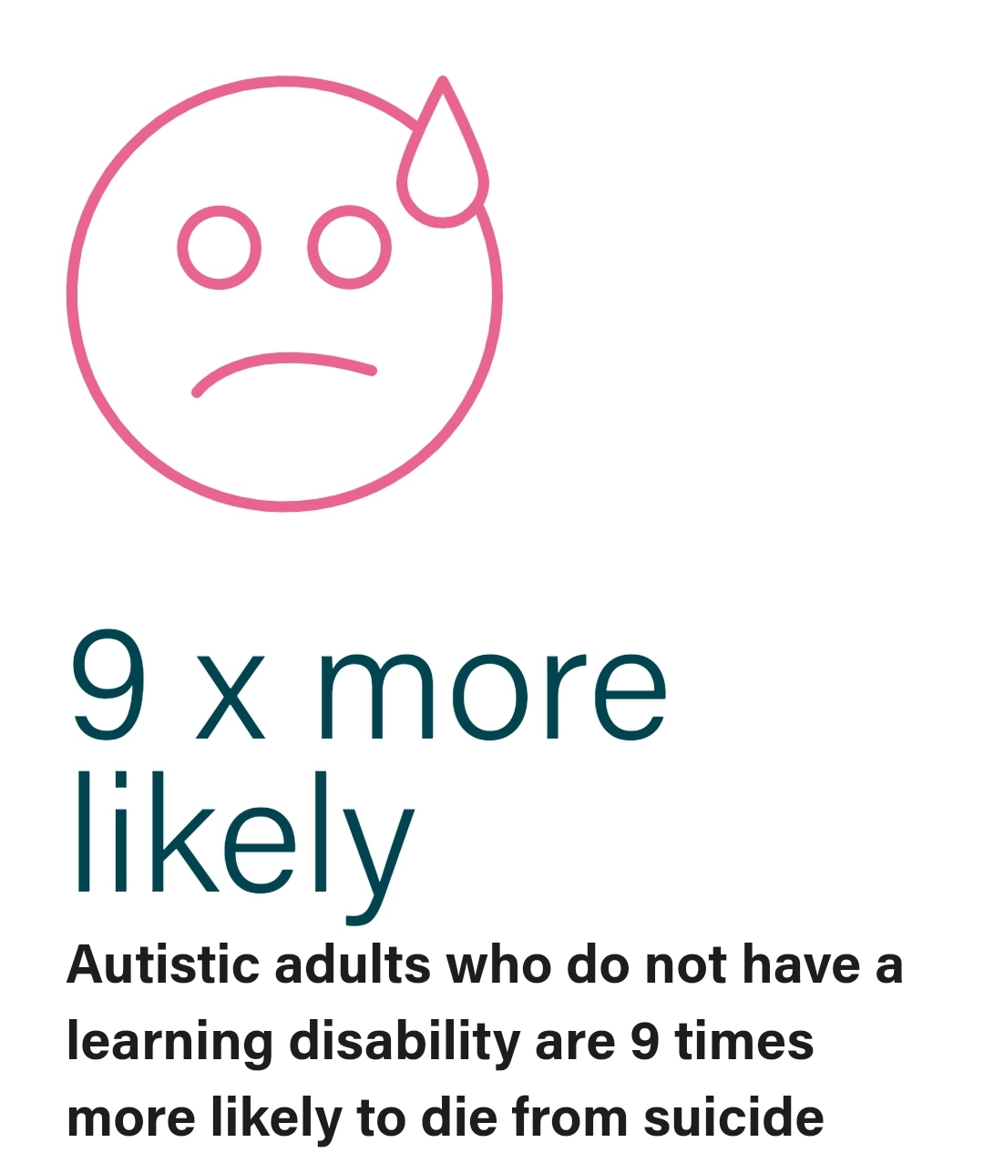
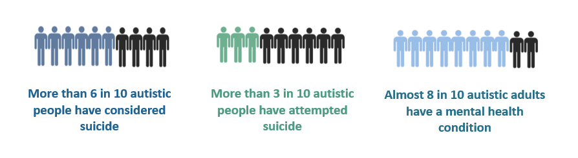
Wellbeing: Depressing Statistics
One of the most important investigations of recent years revealed that average life expectancy of a person with severe autism is 39.5 years, rising to only 58 years for those with high-functioning autism, or Asperger syndrome (thinkingautism.org)
https://www.autistica.org.uk/

Slide 17

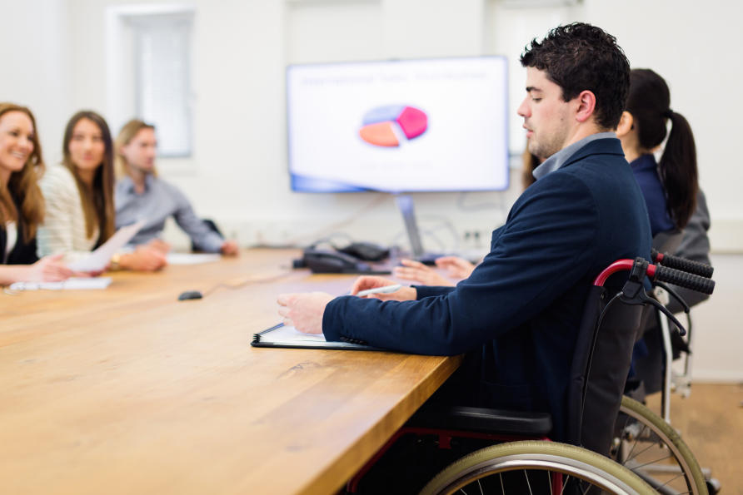
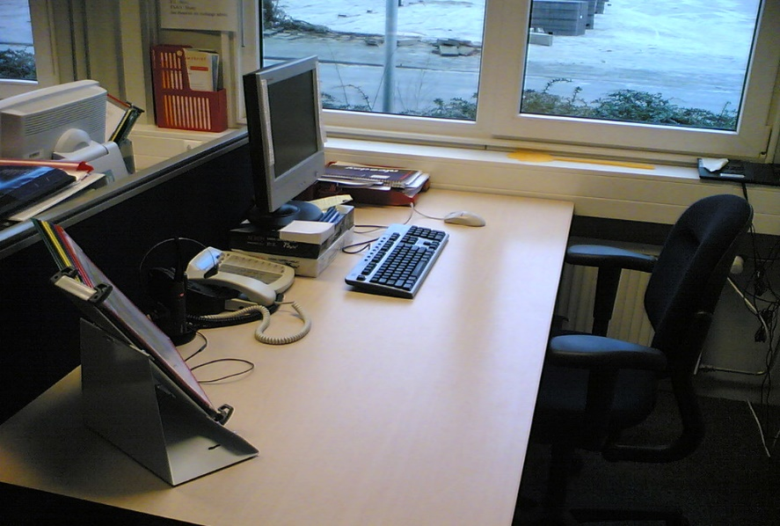
Autism & Employment
Over 80% of non-disabled adults are in work
Around ½ of disabled adults are in work
Only 22% of autistic adults are in employment
Why is this, when so many people with Autism have so many skills that they can bring to a business?
The Office for National Statistics (ONS) Feb 21

Slide 18

Autism & Employment: We Put Up Barriers
Role Definition
Interview Anxiety
Travel and Times
Workplace Culture
Because unknowingly, we set up barriers to people with Autism

Slide 19

Autism: The Positives
Many people with Autism have fantastic skills such as:
Attention to detail
Methodical
Deep Focus
Novel Approaches
Observational Skills
Creativity
Absorb Facts
Resilience
Visual Skills
Accepting
Expertise
Integrity

Slide 20

Autism & Employment: Recognise The Value
Notes:
Employing an autistic person demonstrates your organisations commitment to equality and diversity and shows a positive attitude to disabled people. Having a diverse workforce brings benefits to staff and business alike, and managers and colleagues often describe working with an autistic colleague as an enriching experience that encourages them to think more carefully about how they communicate, organise and prioritise their work.
Can we as a business do better to attract talented people with Autism? I think we could. Could we do more to understand and accommodate their needs? Yes we could, but I think as a wider thing around understanding everyone’s workplace needs and not limited to people with autism. Sadly though I believe the lack of employment and thus missing out in life to all the benefits being employed brings (wage, contacts, interests) means that it contributes massively, to some appalling figures.

Slide 21
Autism & Employment: Recruitment
Do we clearly define the role and how to apply for it
All of these relate beyond an experience for a person with Autism, a more inclusive descriptive less “mystery” around vacancies would help more people to apply for a role.
Is there flexible working / what are the hours
Where is the job located precisely
Is there parking
What is the salary range
What are the benefits
Is it Autism inclusive
Does the job description sound generic
An advert is a marketing opportunity for an organisation, so how do we look?
Do we inform people of how and where to attend an interview
Could we state the main questions we will be asking to enable people to prepare
Would a picture or video from the manager of the position help to humanise the role
Notes:
We get it, but if you stood back and really read the job description does it look like a role that’s inclusive or interesting dare I say?
Shouldn’t we be stating if it’s a desk job if theres flexibility and how and when interviews will occur
What advantage do we really get by not letting people prepare for the questions we really want to ask. Do we tell them when the interviews will be? Do we state wages from band?
‘
Can we accompany the advert with a video from the job poster or the region – imagine an advert for a role goes out and theres a video of a person saying hello, walking up to the office, showing how to get entry, where to park, walking through the office etc? Why not? We have great facilities don’t we? So lets show people. Look we have parking, we have the ebike stop, we have a bus stop, we are walking distance to a café and a supermarket and a gym. These are things that may help people to apply.
Then when there is a role couldn’t we as a business positively identify roles where an internship for a person with autism would be beneficial to us and them?

Slide 22
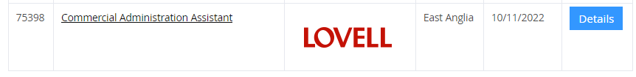
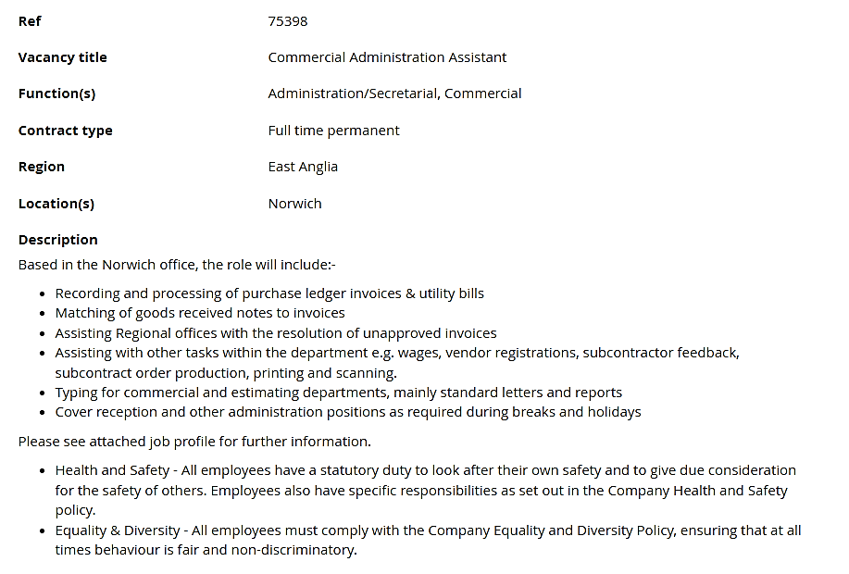
Autism & Employment: Typical Advert
No hours mentioned or precise location
No starting salary
No mention of accessibility for disability or flexibility of role
No hours
Attached profiles don’t give much more information
No dates, questions or locations for interviews

Slide 23
Autism & Employment: Interviews
“Find the best person for the job, not just the one who interviews best.”
Give candidates a detailed outline of what the interview will involve.
If he or she requests it, supply a copy of the interview questions ahead of time to allow that person to get familiar with them. Surely someone coming prepared is better than someone who has communication skills?
Make the candidate feel comfortable, and consider asking what, if any, particular accommodations that person may need to feel at ease in advance of the interview.
Can you have more detailed information available on travel such as a hotel would on their “how to find us” sections?
Be flexible in re-asking or rewording questions to more effectively gather the information that you want.
If the candidate hesitates before answering, allow the person a moment to collect his or her thoughts and give a response. This could be the individual calling upon “filters” in preparing an appropriate answer. Its not a negative for someone to pause.
Its not a negative for someone to appear nervous.
Depending on the skills required for the specific position, consider creating an alternate method to assess the candidate’s capabilities and “fit” for the job. Does a “chat” really find the best person or is simply finding the best communicator?
This might be an observational assessment that could exist in lieu of a formal interview or in conjunction with one. For example, if an interview setting does not represent an individual’s ability to perform the necessary tasks, have the applicant do a sample of the work required for the position as you observe.

Slide 24

Recruitment Summary
Give more details on the job advert to encourage more applications
Ensure accommodations are asked for (and implemented) for interview
Send detailed instructions and location of interview and also send over the main questions relating to the role for discussion
All of which are a waste of time if we have a culture that doesn’t understand Autism

Slide 25

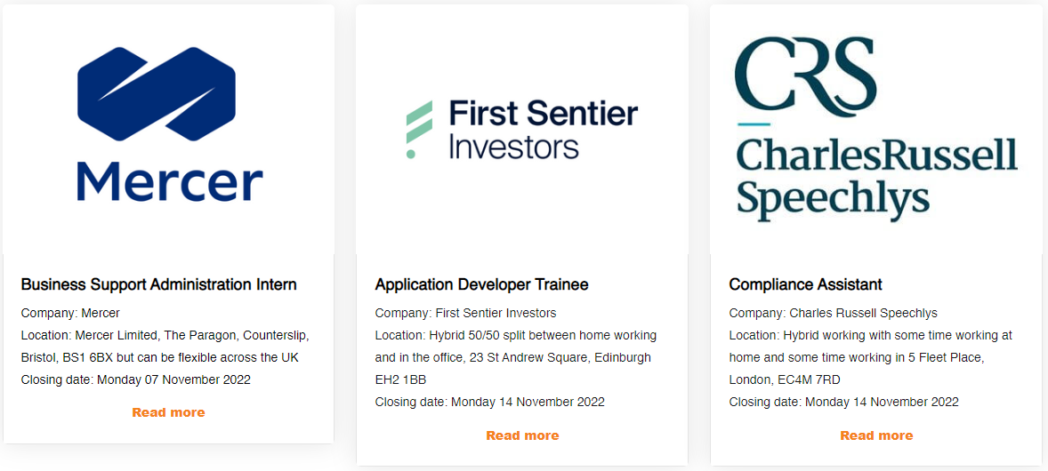
Autism & Employment: Opportunities
Offer internships and experience for decent, skilled positions, for people with Autism. Not only does it help organisations to get highly skilled employees, it helps those people to gain valuable experience of employment and social interaction.
Could you have a role that could be suitable for internship or experience? Do we look to offer placements to People with Autism?

Slide 26
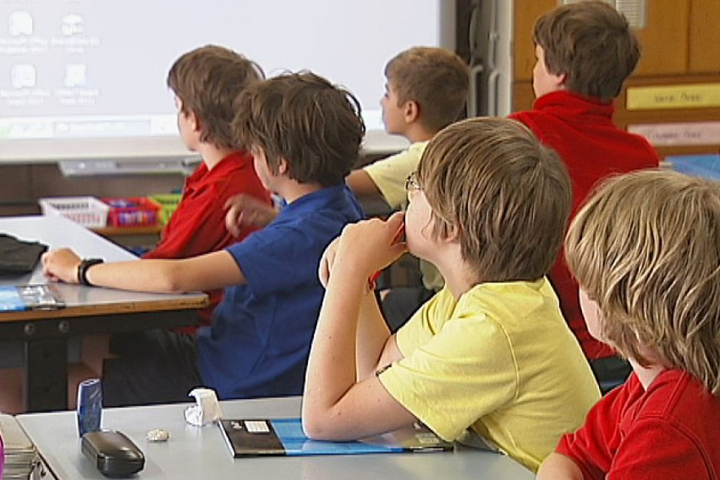
The Work PLACE Experience
But everything has to start earlier.
When children go on work experience, it is to experience a career.
For a child with Autism just breaking routine is hard enough. This is the first step!
Getting organisations to actively accommodate children with Autism for a work place experience is crucial to development.
Build links with a school, build links to that child and make the work place experience the aim, not the role, not the tasks, just being able to gain the confidence of a new environment and routine

Slide 27
How It Is VS How It Should Be
School arrange work experience
Child with autism doesn’t go or is traumatised by the experience
Child lacks the confidence to take the next step after leaving school
Employment options are less
Can employers do more to work with schools to provide work “place” experience as for an autistic child, its not the role that’s important, it’s the experience
School arrange link to employer
Child with autism slowly builds experience of employer
Employer ensures work experience is suited to that child and they gain experience of being out of their usual routine
Child gains confidence, even if masking, to perhaps explore more things in the future

Slide 28

What Can We Do: A Simple Calculation
If we have more accommodating workplaces with a culture of inclusion
Reduction in mental health issues and suicide rates, more people with Autism employed, more diverse workplace benefits
X
(It starts with more Support to children with Autism)
Employing more people who have autism to better diversity and get more people with Autism into jobs or giving opportunity through internships
We have to help people

Slide 29

What Organisations Need To Do – The 3 E’s
Encourage those with autism, who may not want to divulge it, to speak up so accommodations can be made, to make their working life better and to encourage diversity in recruitment
Educate our teams to understand autism to build awareness and understanding to help those with autism but to also educate those in recruitment to offer a better interview experience
Ensure that those who have autism (or any form of disability) are truly able to communicate this freely, are understood and accommodations are made for them, if required and that recruitment policies are autism friendly

Slide 30
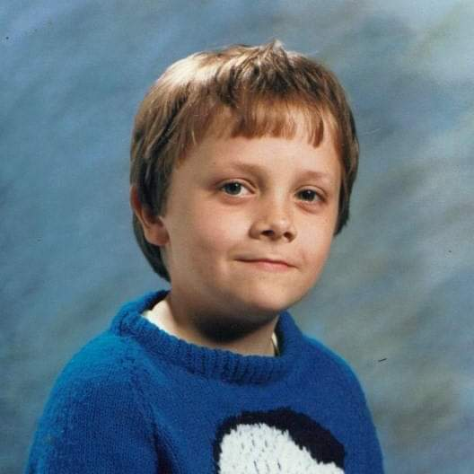

My Journey
From shy, almost silent boy to much louder hairier man

Slide 31
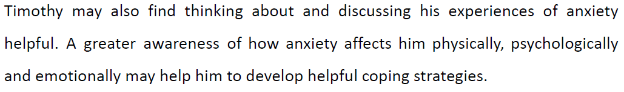
About Me
Regional Procurement Manager, for Lovell, East Anglia
Fully CIPS Degree Qualified in Procurement
Former member of CIPS Congress
Ambassador for the Institute of Supply Chain Management
Singer in an Iron Maiden Tribute Band
I have Autism!
I have a strange sense of humour
And the Doctor said…

Slide 32
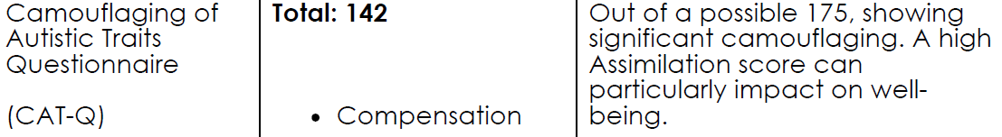
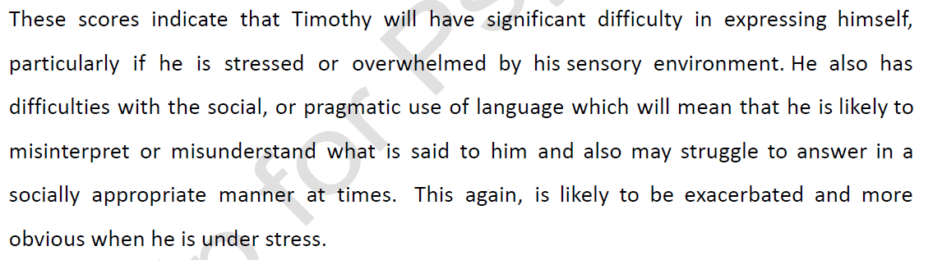

Key Points From My Assessments

Slide 33
My Experiences: Said vs Am
What They Have Said | How I am
You don’t follow my rules | I see rules that are not logical and I have to try to do things better as I see patterns and solutions to things. I also cannot do anything unethical. If its wrong to me…its wrong
Your emails are not polite enough | I don’t realise and I consider emails as a system to ask for or do something tool
You are 100mph and you need to slow down | I cannot and I need to do get things done
You are scruffy and don’t dress appropriately | I try really hard to the point that even my “scruffy” is uncomfortable to me, so further comment just makes me feel worse. You have no idea how uncomfortable it is
You didn’t show enough respect to the Directors and need to watch how you talk to them | I don’t have prejudice; people are people, position is a title and I will talk to get my point across, which I cannot help
You have your earphones in too much | I need to block out the noises and it’s a coping mechanism to me. Sometimes I will just vanish off
You are impatient, we are looking into it | If something can be done do it. I don’t understand the politics or why some people are treated better

Slide 34
My Experiences: How Autism Effects Me
A lot of the time, I just want to be left alone
Sometimes I don’t want to be here anymore
I am good at finding solutions to problems
I often think I have an answer to it
I am not so good at being told what to do
I interrupt people all the time and can come across as sticking my beak in
I do like logic and routine to a lot of stuff
I thrive under stress and get it done
I get frustrated when I cant see it in tasks I am set or in work by others, even if it doesn’t directly effect me
I get bored easily if there’s no challenge
I am good at my job because of how I see logic and patterns in things
I’m engaging when talking about what I enjoy and what I am into
I don’t feel I am accepted by those above me because of how I dress/act and speak which can make me feel down
I am useless at every day social interaction and feel uncomfortable when I am not in control of the situation
I mask really well
I just cannot sleep. Like Ever. I cant fix it.
But it exhausts me

Slide 35
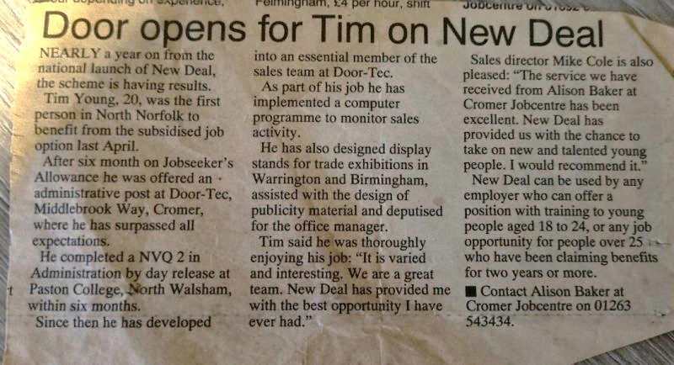
Employment: I Got Lucky
At 20, I was placed into employment via the Job Centre, who saw that I had ability, but lacked the confidence and social skills to be successful in job interviews
Without this I may never have got into the positions that I have through my career
This is why I support organisations being pro active in understanding Autism and actively giving opportunities to those that have it
The barriers are removed

Slide 36
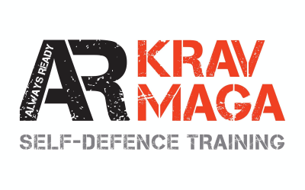



Has Autism Stopped Me?
In 2022 I won an award from The Institute Of Supply Chain Management
I was also shortlisted as a finalist as a mentor for UK Construction Week
I completed a Krav Maga training course (just being around lots of people in that environment was a challenge in itself)
I also raised a lot of money for charity with my efforts to raise awareness of the issues around food availability for refugees
Often it does but 2022
proved to be a year
in which I was busy
and perhaps one
to try and shout about
(for once) to hopefully
inspire others
Notes:
For me, winning an Award (unexpectedly as well) in October 2022 is the highlight of my entire working life.
It recognised the efforts I have put into my profession and all I do to help others on their journeys. I volunteer and I tutor procurement in my own time. I often do charity work, starving myself in 2022 for ration week, 2021 a walking challenge for autism, 2020 I helped a terminally ill child and his family. The point being my determination which I attribute to Autism has been more helpful to me than I have ever realised.
I am not a person to boast, nor am I interested in awards in any way, but after winning it I thought to myself:
“this shows what someone who has Autism, who doesn’t believe in themselves and who still thinks they don’t fit in, can achieve”.
Perhaps I should shout about it, because if it inspires one person with Autism to believe in themselves then that’s all that matters.

Slide 37

In Summary
Having Autism is not a barrier to doing what you want to do in life…If you can understand yourself and your strengths/triggers then you are a step ahead of others. If you don’t have autism, being aware of it and accepting it makes you a better person.
As people with it or employers without Autism, we need to embrace the benefits of Autism and actively encourage diversity. As employers we can choose to make a difference, what is stopping us from doing the right thing?
People with Autism wont fit in to everyone else’s version of “normal” and that’s a good thing, without diversity the world would be pretty dull, we all have to stop striving for conformance and look for performance
If you have Autism stop looking for acceptance from others or to fit in to a narrative that isn’t part of your story. You are unique and you will be happiest by chasing your interests than chasing acceptance from other people
Notes:
So having Autism can be hard at times. But life is hard for everyone. We are all different, even you normal people, bless your tiny minds (I'm joking). I'm not. They are like Dinosaurs. One day us Autistic people will rule this planet. Until then thank you for having me on to discuss this.

Slide 38

Goals From This Presentation
More Organisations make their workplaces more autism friendly
Recruitment Policies change to make job adverts more accommodating
Companies look into work experience and internships for people with Autism
People with Autism get the changes they need in their employment
More people with Autism get employment and remain employed
The suicide rate and life expectancy both show statistical improvement due to more people with Autism being employed

Slide 39

Doing The Right Thing
Can You make a difference?
Are We doing the right thing?

Slide 40
Quote from IoSCM
“
Adults with Autism often face additional challenges in the workplace, this can be due to a lack of understanding, feeling unsupported and poor communication. IoSCM support the raising of awareness within employers to support them in getting the best from all employees, developing talent and ensuring inclusion.
Jacky Stansfield Smith, CEO
Institute of Supply Chain Management (IoSCM)
”

